Slide 2
Background, Board and Leadership
Recommended by the DDA Supported Living Committee in 2019 as one of 3 strategies to help Marylanders with I/DD gain information and access to accessible, affordable housing
MIH was founded in 2020 as a non-profit
MIH Board members
Disability Advocate
CCS agencies
DD Council
Residential service providers
CMS
County Department of Housing and Community Development
Finance/Banking Industry
Realtor
MIH Leadership
Tim Wiens, Executive Director
Lauren Silverstone, Community Living Specialist
Terri Bradford, Administrative Assistant

Slide 3
MIH Mission and Goals
Mission
“Maryland Inclusive Housing Corporation’s mission is to help people with Intellectual and Developmental Disabilities (IDD) successfully access and maintain inclusive, affordable, and accessible housing of their choice by creating opportunities, identifying resources, connecting people, and providing services.”
Goals
To facilitate the creation of housing committees in regions or counties throughout the state
To employ Community Living Coordinators who would work as housing case managers for individuals who are receiving DDA services or are on the DDA waiting list
To be a housing information clearing house for DDA, for individuals with IDD and their families and for CCS workers and service providers

Slide 4
Accomplishments to Date
To facilitate the creation of housing committees in regions or counties throughout the state
Committees have been established in Montgomery County, Baltimore City and Howard County
Committee leadership
Members include local self-advocates, family members, housing experts (developers, public housing authority staff) government officials, service providers, Centers for Independent Living
To employ Community Living Coordinators who would work as housing case managers for individuals who are receiving DDA services or are on the DDA waiting list
Lauren Silverstone is employed as the first Community Living Specialist and provides Housing Support Services to people with disabilities wishing to transition to independent renting
Others will join MIH as the organization grows
To be a housing information clearing house for DDA, for individuals with IDD and their families and for CCS workers and service providers
The MIH clearing house/website was launched in early July 2021 and contains information on housing resources, supports and opportunities

Slide 5
Clearing House www.mih-inc.org
Home Page
Includes a form to sign up to receive communications from MIH
Housing Info Page
Housing, Medicaid and Social Security
Thinking About Renting or Owning a Home
Learning About Renting or Owning a Home
Renting
Owning
Housing Accessibility
Services in Your New Home
Preparing to Move
Utilities
Moving
Laws Providing Protections for People with Disabilities
Housing Services page
Introduction to Lauren Silverstone and the HSS services she can provide
Includes an application for services
In the future, will include information about other HSS providers

Slide 6
Housing Information Page
Housing, Medicaid and Social Security
SSI Rules Related to Housing
Presumed Maximum Value
SSDI
Retirement Income
Is a Home an Asset
ABLE Accounts and Paying for Housing
HCBS Settings Rule
Maryland Medicaid Waivers
Maryland Medicaid State Plan Services

Slide 7
Thinking About Renting or Owning a Home
When am I ready?
Concerns and addressing concerns
DDA support services to help someone in their own home
Concerns about staffing
Making an informed choice

Slide 8
Learning About Renting or Owning a Home
Learning about renting
What is a lease?
What are community rules and how are they different from a lease?
What is a security deposit?
What is a landlord and what do they do?
Who fixes things when thy break?
Can I move whenever I want to?
Can I have other people live with me?
Can I have overnight gests whenever I want to?
Will I be allowed to smoke?
Learning about Homeownership
Basic Decisions
Who will I live with?
Live-in caregiver
Where will I live?
What are my accessibility needs?
What can I afford?

Slide 9
Renting
Renting a Home
Options for making renting affordable
Types of rent subsidy programs
Tenant-based
Project/Unit-Based
Affording rental housing without a subsidy
Getting help with thinking about housing
Finding affordable rental housing
Applying for rental housing
Being a successful tenant
Tenancy issues
Recertification/lease renewal

Slide 10
Owning
Owning a home
Housing counseling
Realtors
Mortgage programs
Home purchase by special needs trust
Home purchase by family
Being a successful owner
Mortgage payment plan
Maintaining your home
Financing home improvement
HOA rules and compliance

Slide 11
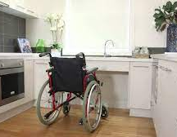
Housing Accessibility
Physical accessibility
Fair Housing Act, ADA and UFAS accessibility standards
Sensory accessibility
Funding accessibility modifications

Slide 12
Services in Your New Home
Planning ahead for what you will need
Creating a housing plan
Timing of services and signing the lease
Live-in aides

Slide 13
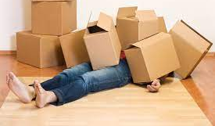
Preparing to Move
Expenses to consider
Resources for basic household items
Keys
Changing your address
Setting up utilities
Renters insurance

Slide 14
Utilities and Moving
Utilities
Who covers the utilities?
Deposits
Assistance with payments
Saving on bills
Moving
Giving notice
Notifying utilities
Getting your security deposit back

Slide 15
Laws Providing Housing Protections for People with Disabilities
Federal Fair Housing Act as Amended
Maryland Fair Housing Act
Section 504 of the Rehabilitation Act of 1973
Americans with Disabilities Act
Reasonable Accommodations
Reasonable Modifications

Slide 16
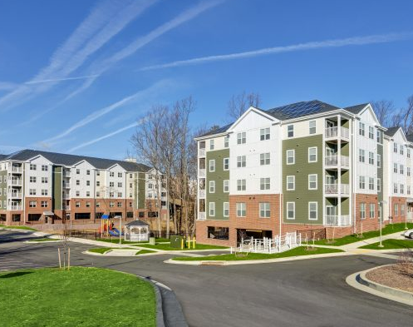
Housing Support Services

Slide 17
Community Pathways Waiver Definition
Time-limited supports to help participants navigate housing opportunities, address or overcome barriers to housing, and secure and retain their own home.
Includes:
Housing Information and Assistance
Housing Transition Services
Housing Tenancy Sustaining Services

Slide 18
Housing Information and Assistance
Understanding housing program rules and requirements and their applicability to the participant
Searching for housing
Applying for housing, including obtaining documentation
Assessing the unit to determine if it meets accessibility & safety needs and is ready for occupancy
Requesting reasonable accommodations/modifications
Identifying resources for security deposits, moving costs, furnishings, assistive technology, environmental modifications, utilities and other one-time costs
Reviewing the lease and other documents including community rules prior to lease signing
Developing, reviewing, and revising monthly budget
Identifying and addressing barriers to housing such as credit, rental history, criminal background, and behaviors
Assistance with resolving disputes

Slide 19
Housing Transition Services
Conduct tenant screening and housing assessment
Collect information on potential barriers to housing
Identify potential housing retention challenges
Develop individualized housing support plan that includes
Short and long-term goals
Strategies to address barriers including prevention and early intervention services when housing is jeopardized
Natural supports, resources, community providers, and services to support goals and strategies

Slide 20
Housing Tenancy Sustaining Services
Assist participant to maintain living in leased home including:
Education and training
How to be a good tenant
Role, rights, and responsibilities of tenant and landlord
Lease compliance
Coaching to develop and maintain good relationships with landlord/property manager and neighbors
Assistance with recertification process
Early identification of behaviors that jeopardize tenancy
Assistance with resolving disputes with landlords and/or neighbors
Advocacy and linkage with community resources to prevent eviction
Review, update and modify housing support plan in coordination with participant

Slide 21
Home Ownership

Slide 22
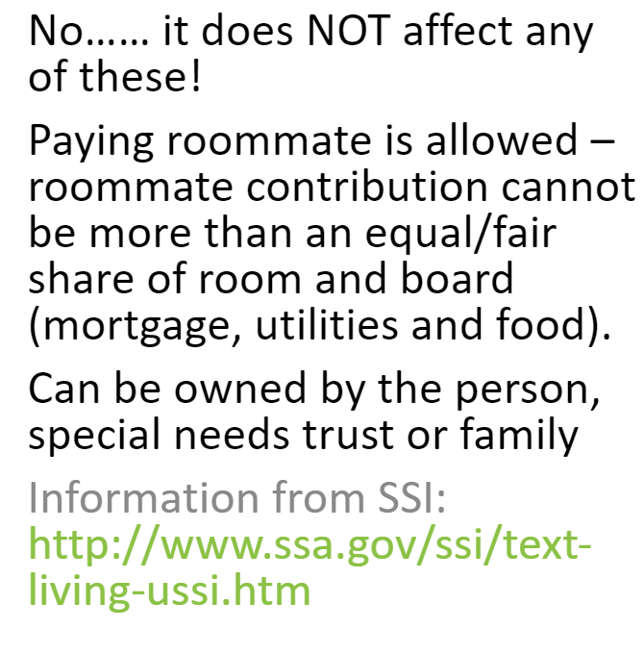
Does owning a home affect Medicaid, SSI, or SSDI benefits?

Slide 23
Home Purchasing Programs
HomeAbility - ​ assists Maryland homebuyers with disabilities to finance their home purchase. https://mmp.maryland.gov/Pages/HomeAbility/default.aspx
Maryland Mortgage Program - provides 30-year fixed-rate home loans and down payment assistanc to eligible homebuyers purchasing in Maryland.
https://mmp.maryland.gov/Pages/About-CDA.aspx

Slide 24
Home Purchased By Family
A family may have the resources to purchase a home for their loved one with a disability or to allow the person to continue to live in their home when they move to another place. It is important that the impact of the family assistance with room and board costs on SSI income be understood and considered. Remember that the “presumed maximum value” of assistance with room and board will be about 1/3 of the SSI check.

Slide 25
Presumed Maximum Value
According to SSA, suppose you live alone and your only income is SSI. Your brother pays your rent of $800. We count this payment as in-kind support and maintenance. Although the rent is $800, we limit how much of the $800 we count by using a presumed maximum value (PMV) rule. The PMV is equal to 1/3 of the Federal benefit rate plus $20. Here are the steps we use to figure the SSI benefit amount.
1. The SSI Federal Benefit Rate is $794.00. 2. One-third of the SSI Federal Benefit Rate of $794 is $264.66. 3. $264.66 (1/3 of the Federal Benefit Rate) +$20.00 (from the PMV rule) =$284.66 (the PMV of in-kind support and maintenance) 4. $284.66 (the PMV of in-kind support and maintenance) -20.00 (general income exclusion) = $264.66 (the amount of the reduction due to in-kind support and maintenance) 5. $794 (Federal Benefit Rate) -$264.66 (reduction due to in-kind support and maintenance) = $529.34 (your SSI benefit amount)

Slide 26
Home Purchase through a Special Needs Trust
Many families with a loved one who has a disability have created a “special needs trust” to help manage the financial needs of their loved one. The issue of housing is often part of the planning through a special needs trust. Some families would prefer that the loved one continue to live in the family home, while others wish to plan for their loved one to have a different home. In addition, families are likely to consider the options of their loved one renting vs owning a home.
The Arc US has prepared information to assist families with these considerations. Go to the website below to learn more: https://thearc.org/owning-home-special-needs-trust/

Slide 27
ABLE Accounts
Help individuals with disabilities save money and pay for qualified disability-related expenses without jeopardizing state or federal means-tested benefits such as SSI or Medicaid.
Can contribute up to $15,000 per year (or more if the beneficiary is working) for a wide range of qualified disability expenses.
ABLE account funds can be used to pay for your housing costs, including rent, mortgage, property taxes, utilities (gas, electric, water sewer), condo fees, home maintenance, etc.

Slide 28
Renting a Home

Slide 29
Tenant Based Voucher – Housing Choice
Based on income – Tenant pays 30% of household income towards rent and utilities.
Apply through Public Housing Authority.
Can apply for any apartment in the jurisdiction within payment standards.
Generally it is one bedroom per individual. Reasonable accommodations can be requested for additional room for medical equipment or live-in aide is needed.
Voucher follows tenant if they choose to move.

Slide 30
Voucher Rent Example
For example, a person receiving SSI of $783 a month and who lives alone will need to pay approximately $235 for rent and utilities each month. If the same person lives with a roommate who also receives $783 in SSI a month, the household income is now $1,566 and you and your roommate will need to pay $470 for rent and utilities.

Slide 31
Project Based Voucher Programs
Based on income – Tenant pays 30% of household income towards rent.
The subsidy is tied to the apartment. If they decide to move to a different apartment community, they cannot take the rent subsidy with them.

Slide 32
Section 811 Project Rental Assistance Program
Who is eligible?
People with disabilities who are:
Age 18 to under age 62 at the time of leasing
Medicaid recipients
Extremely low income – at or below 30% AMI (Area Median Income)
Eligible for long term supports and services in Maryland
Do not have a criminal background that includes a lifetime sex offense registry requirement
Do not have a criminal background that includes conviction of the production of methamphetamines in Federally-assisted property
How are Applicants Prioritized?
People transitioning from an institution to the community
People at risk of institutionalization due to their housing situation, I.e., homebound, substandard housing conditions
People moving to independent renting from DDA residential services (group home, enhanced supports, shared living); Brain Injury waiver; BHA Residential Rehabilitation Program; or living in an assisted living facility licensed by the MDH Office of Healthcare Quality.
People who are Homeless and Medicaid recipients (as defined by HEARTH Act) in this order:
Actually homeless
Imminent risk of homelessness
Homeless under other Federal statutes (i.e. unaccompanied youth/families w/ youth)
Fleeing domestic violence
How to Apply: Contact your Housing Support Services provider. Ask your CCS to include a housing goal in your PCP and help you choose a HSS provider. Your HSS provider will complete the pre-screening and application for you.

Slide 33
Weinberg Apartments Program
In order to qualify for assistance, applicants must:
Be between the ages of 18-62
Be disabled and receiving SSI or SSDI
Have a gross household income at or between 10-30 percent of AGMI (Area Gross Median Income) in the Maryland county in which they wish to reside
Not have a criminal background that includes a lifetime sex offense registry requirement
Not have a criminal background that includes conviction of the production of methamphetamines in Federally-assisted property
How to Apply: Contact your Housing Support Services provider. Ask your CCS to include a housing goal in your PCP and help you choose a HSS provider. Your HSS provider will complete the pre-screening and application for you.

Slide 34
Low Income Housing Tax Credit
Low Income Housing Tax Credit and other state-funded multi-family communities get special funding from the government to build affordable housing. The homes are typically apartments.and can be rented by people with income that is between 30% and 60% of Area Median Income. Depending on your income and other resources, you may be able to afford to rent one of these apartments without a rent subsidy.

Slide 35
Resources
Public Housing Authority List - https://www.hud.gov/states/maryland/renting/hawebsites
Section 811 Project Rent​al Assistance - http://mdod.maryland.gov/housing/Pages/section811.aspx
Weinberg Apartments – http://mdod.maryland.gov/housing/Pages/MPAH.aspx
Affordable Housing Search -
MD Housing Search - https://www.mdhousingsearch.org/
Affordable Housing Online - https://affordablehousingonline.com/
Low Income Housing - https://www.lowincomehousing.us/MD.html
HUD – www.gosection8.com

Slide 36
Need housing information?
Please sign up on our website or contact Lauren for assistance.

